Slide 1
ML Project
Master Degree in Computer Science (AI)
Project Type: A
Presented To: Prof. Alessio Micheli
Presented By: Karol Cardona and Udit Gagnani
Presented On: XYZ ABC, 2025
Notes:
Hello

Slide 2
Objectives
Design and develop a framework from scratch to build a neural network that can efficiently handle classification and regression tasks.
Moreover, the framework has been rigorously evaluated on Monk’s problem and subsequently applied on ML-CUP dataset, showcasing its versatility and effectiveness in real-world machine learning tasks.

Slide 3
Method
We developed a multi-layer fully connected feed-forward neural network, utilizing backpropagation for weight optimization. The training process employs mini-batch gradient descent ensuring efficient convergence by iteratively minimizing the error function, thereby boosting the overall performance and generalization capability of the model.

Slide 4
Explorations
Activation Functions
Weight Initializations
Other Techniques
Sigmoid => σ(x) = 1 / (1+e^{−x})​
TanH => tanh(x) = (e^{x}−e^{−x})/(e^{x}+e^{−x}) ​
ReLU => ReLU(x) = max(0, x)
ELU => ELU(x) = x if x≥0
=> ELU(x) = α(e^{x}−1) ​if x<0​
Leaky_ReLU
=> Leaky ReLU(x) = x if x≥0
=> Leaky ReLU(x) = 0.01x ​if x<0​
Momentum
Nesterov Momentum
Hold - Out
K-fold Cross Validation
Early Stopping
Dropout
Learning Rate Decay
Balancing Data
Random & Grid Search
Gaussian => W∼N(μ, σ²)
Where μ and σ are the mean and standard deviation from the init_range parameter, respectively.
Xavier => W∼N(0, 1/n_{in}​​)
Where n_{in}​ is the number of input units for the layer.
He => W∼N(0, 2/n_{in}​​)
Glorot
Orthogonal
Range

Slide 5
Working with Monk Dataset

Slide 6
The input features of the Monk’s datasets were preprocessed using one-hot encoding, resulting in an input layer with 17 units.
For Monk-1 and Monk-3, the architecture includes a hidden layer with -- neurons, while Monk-2 features a hidden layer with -- neurons.
To prevent overfitting and optimize training, early stopping has been implemented, with the validation loss serving as the criterion to halt the training process.
Monk’s Architecture

Slide 7
Monk’s Results
Problem | Hyperparameters(#Neurons, Eta, Momentum, Activation, Decay, Batch Size, Weight Initialization) |  | MSE (Training / Testing) | Accuracy (Training / Testing)
MONK-1 | 4, 0.13, 0.9, Sigmoid, 0, 2, Gaussian |  | 0.0033 / 0.0046 | 100% / 100%
MONK-2 | 4, 0.16, 0.9, Sigmoid, 0, 2, Glorot |  | 0.0000 / 0.0000 | 100% / 100%
MONK-3 | 4, 0.16, 0.85, Sigmoid, 0.75, 2, Gaussian |  | 0.0276 / 0.0126 | 95.92% / 98.84%

Slide 8
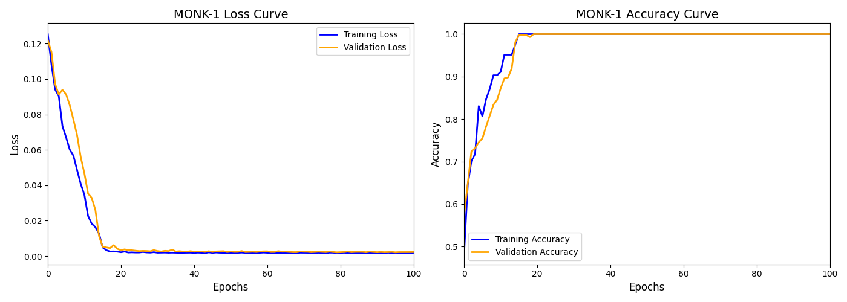
Monk-1’s Results

Slide 9
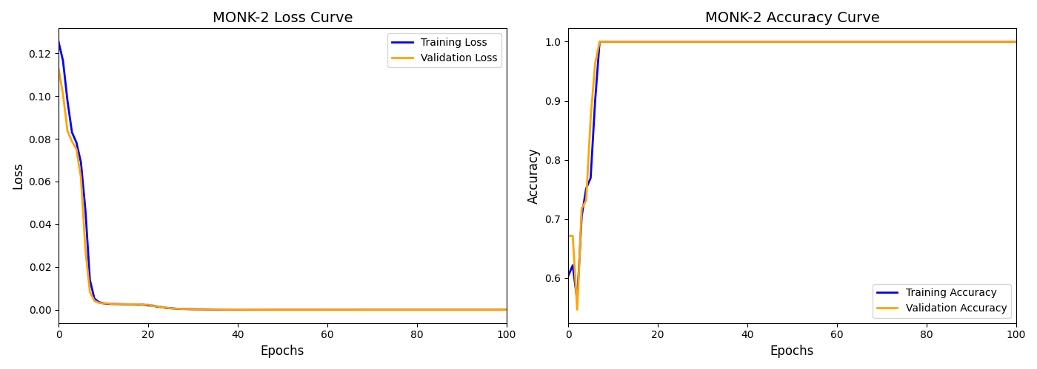
Monk-2’s Results

Slide 10
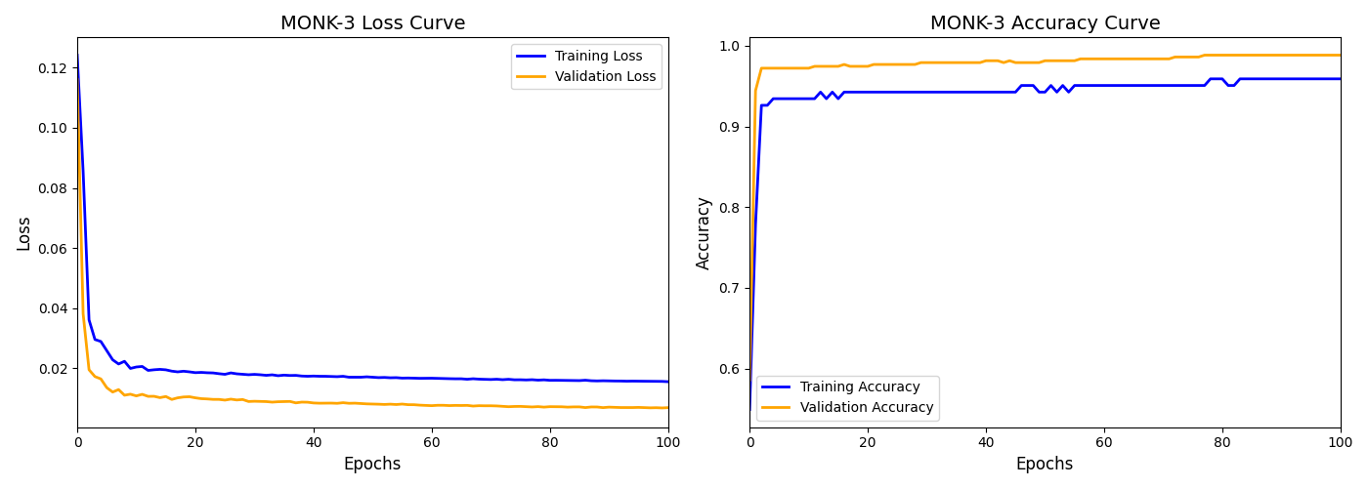
Monk-3’s Results

Slide 11
Working with CUP Dataset

Slide 12
The CUP dataset was processed using a 5-fold cross-validation framework, with each fold undergoing randomized and grid-based hyperparameter optimization over a custom MatrixMLP architecture.
Key regularization techniques included dropout, L1/L2 penalties, and early stopping, with multiple weight initialization strategies explored.
A diverse search space spanned activations, optimizers, learning rates, and batch sizes. Top configurations from random search were refined through focused grid search.
The best-performing model was retrained on the full dataset and evaluated on a blind test set to ensure robust generalization.
CUP’s Architecture

Slide 13
ML Cup Approaches
Hyperparameters | Possible Values
Layer Size | [60, 60], [80, 60], [100, 70], [120, 80], [150, 100, 50], [200, 200], [50, 50, 50]
Learning Rate | [0.00016, 0.00027, 0.00046, 0.00077, 0.00129, 0.00215, 0.00359]
Dropout Rate | [0.0, 0.1, 0.2, 0.3]
Momentum | [0.7, 0.8, 0.9]
Activation | Sigmoid, ReLU, Leaky_ReLU, ELU
Decay | 0.0, 1e-4, 1e-3
Batch Size | [8, 16, 32, 64, 128]
Weight Initialization | Xavier, He, Glorot, Orthogonal, Range
Patience | 50, 100, 150

Slide 14
CUP’s Results
Problem | Hyperparameters (#Neurons, Eta, Momentum, Activation, Decay, Batch Size, Weight Initialization, Patience) |  | Mean Squared Error (Training / Testing) | Loss Var (Training / Testing)
CUP 2024 | [50, 50, 50], 0.0003, 0.8, Leaky_ReLU, 0.001, 64, Glorot, 100 |  | 0.2248 / 0.1869 | 0.1124 / 0.0935

Slide 15
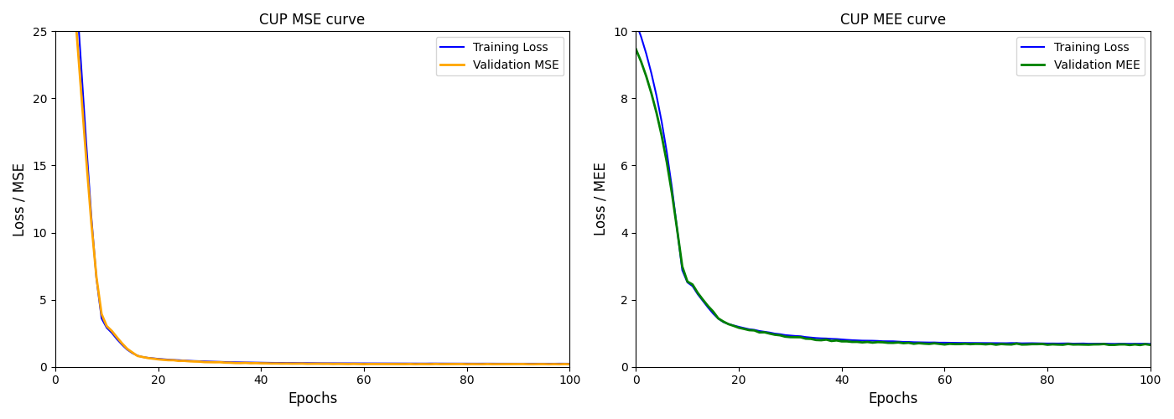
CUP’s Results

Slide 16
Working on this project was both challenging and rewarding. Building our own neural network framework from scratch pushed us to move beyond surface-level understanding and truly engage with the underlying mechanics of training and optimization.
Each design decision (from choosing activation functions to fine-tuning hyperparameters) taught us how even subtle changes can greatly affect performance.
This hands-on experience not only reinforced what we learned during the course but also gave us a deeper appreciation for the trial-and-error nature of real-world machine learning.
Conclusion

Slide 17
Thank You

